Slide 1
Customize PyTorch memory allocation strategy and introduction to CUDA Stream-ordered Memory Allocator
20230517
박현우

Slide 2
Table of Contents
PyTorch Memory Management
CUDA Stream
Background for CUDA Stream-ordered Memory allocator
CUDA Stream-ordered Memory allocator
CUDA Stream-ordered Memory allocator for Multi-GPU
Benchmark

Slide 3
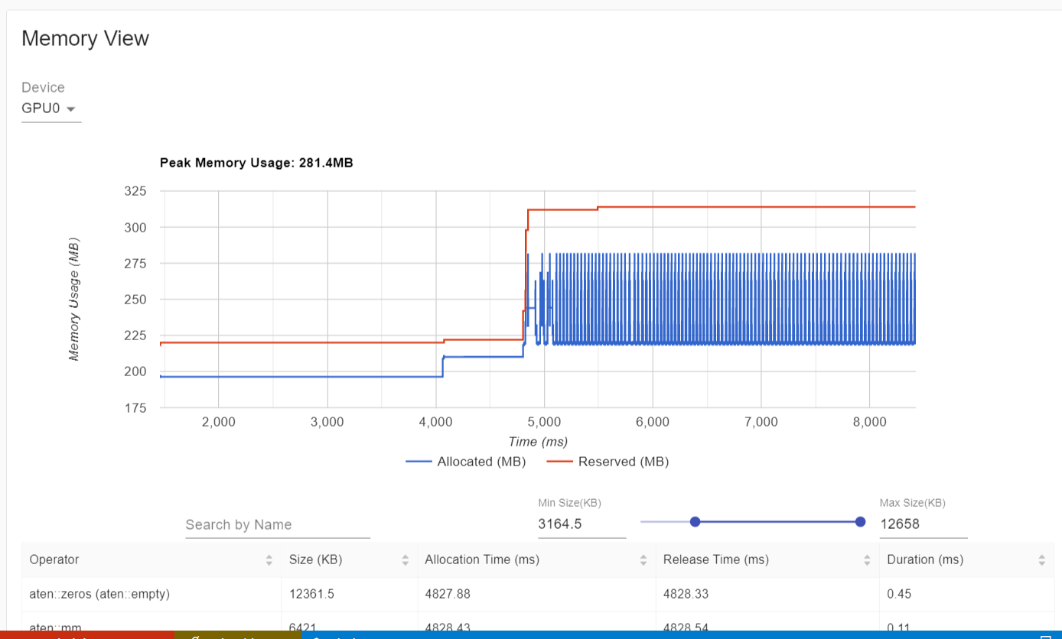
PyTorch Memory Management
PyTorch uses a caching memory allocator to speed up memory allocations.
This allows fast memory de/allocation without device synchronizations; D2H, H2D, Device to remote device, etc.

Slide 4
PyTorch Memory Management
Specifically:
Reserved Memory : total amount of memory managed by the caching allocator.
Allocated Memory : memory substantially occupied by tensors.

Slide 5
PyTorch Memory Management
PyTorch currently provides following underlying allocator implementation.
native (default) which uses PyTorch’s native implementation
cudaMallocAsync which uses CUDA’s built-in asynchronous allocator.
Customizing PyTorch memory allocator is only available for cudaMallocAsync.

Slide 6
1.1. Customizing PyTorch CUDA Memory Allocator
To define custom CUDA memory allocator,
define allocators as simple functions in C/C++
and compile them as a shared library.
To apply custom CUDA memory allocator,
supply the path to the .so file and the name of the alloc/free functions (in C/C++) to torch.cuda.memory.CUDAPluggableAllocator.

Slide 7
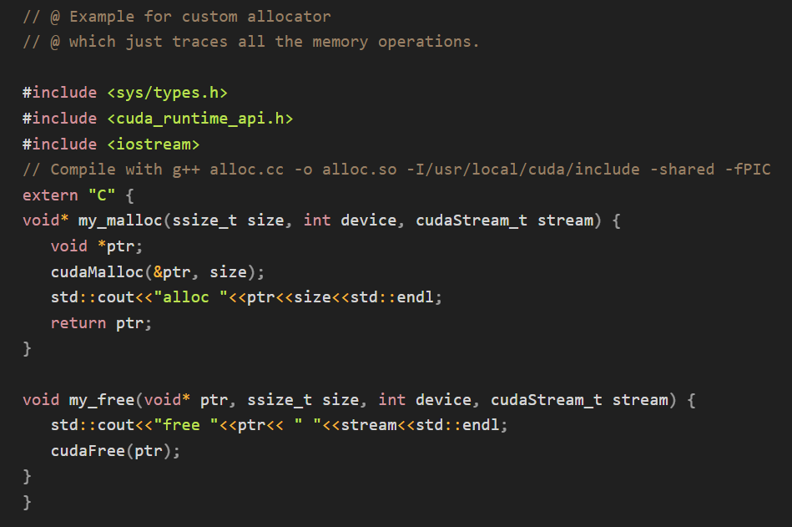
1.1. Customizing PyTorch CUDA Memory Allocator

Slide 8
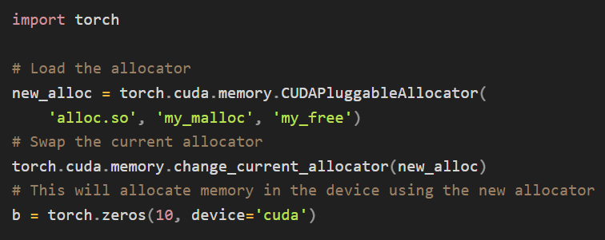
1.1. Customizing PyTorch CUDA Memory Allocator

Slide 9
2. CUDA Stream
By default, GPU operations are asynchronous :
When you call a function that uses the GPU, the operations are
enqueued to the particular device,
but not necessarily executed immediately.
This allows us to execute more computations in parallel.
Therefore, to maximize GPU performance, need to maximize asynchronicity of GPU.

Slide 10
2.1. Asynchronicity of GPU ops
However, some ops are synchronous, making the entire device blocked for sync;
e.g. ops involving time (as time measurements without synchronizations are not accurate) or copy
Such synchronization of ops greatly deteriorates the performance of GPU.

Slide 11
2.2. Explicitly using non_blocking argument
Several functions (such as to(), copy_()) admit an explicit non_blocking argument, which lets the caller bypass synchronization when it is unnecessary.
(Internally, leveraging copy engine alongside kernel engine.)
Under the hood, PyTorch automatically performs necessary synchronization when copying data
between CPU and GPU
or between two GPUs.

Slide 12
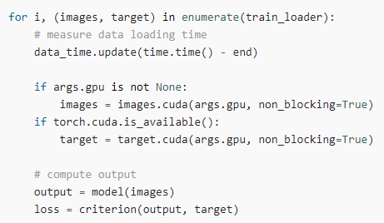
2.2. Explicitly using non_blocking argument
But
when customizing, managing such functions is responsible for users,

Slide 13
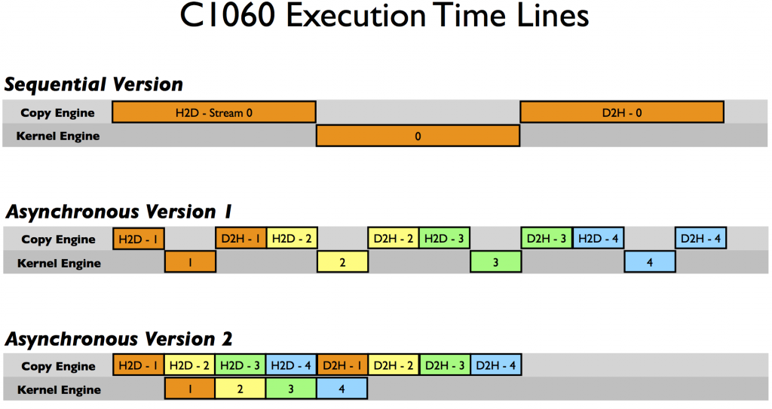
2.2. Explicitly using non_blocking argument
But
2. can’t fine-grain control the behavior, thus, there may be no much gain.
(e.g. re-ordering block of sub-ops to overlap.)

Slide 14
2.3. CUDA Stream
Another exception for such synchronous ops is CUDA stream.
A CUDA stream is a linear sequence of execution that belongs to a specific device.
Operations inside each stream are serialized in the order they are created
Operations can execute concurrently from different streams in any relative order,
unless explicit synchronization functions are used. (such as synchronize() or wait_stream())

Slide 15
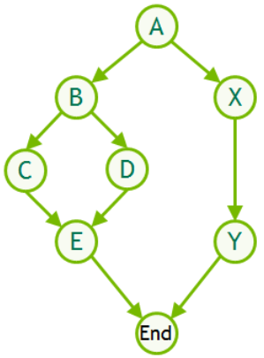
2.3. CUDA Stream
Stream 1
Stream 2
From computation graph (CUDA Graph),
Stream 1 and Stream 2 are captured
and are executed concurrently.
NOTE : For simplicity, assume using single device.
(But the same logic can be extended to multi-gpu and multi-machine)

Slide 16
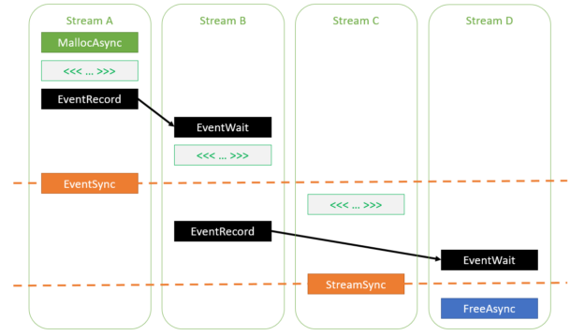
2.3. CUDA Stream
Single GPU

Slide 17
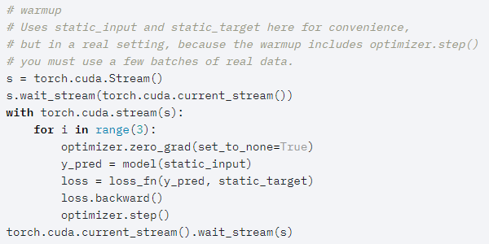
2.3. CUDA Stream

Slide 18
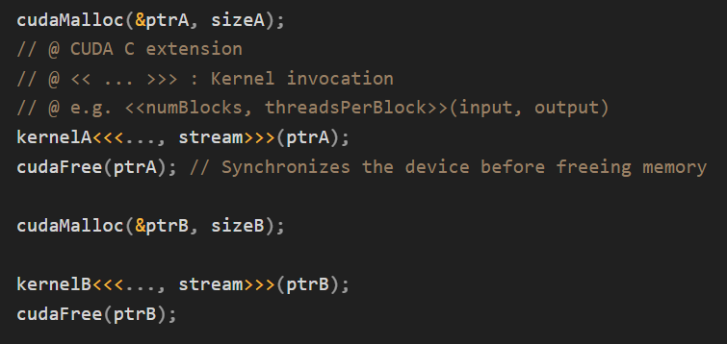
3. Background for CUDA Stream-ordered Memory allocator
Problem: cudaMalloc and cudaFree API functions, which are used to allocate/release GPU accessible memory, are not stream ordered.
This is inefficient
because the first cudaFree call has to wait for kernelA to finish,
so it synchronizes the device before freeing the memory.

Slide 19
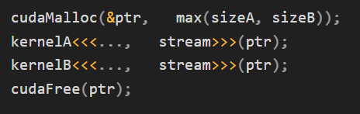
3.1. Problem: Synchronous cudaMalloc and cudaFree
To make this run more efficiently,
the memory can be
allocated upfront
and sized to the larger of the two sizes.
So, kernelB now no needs to wait due to synchronization by cudaFree.

Slide 20
3.1. Problem: Synchronous cudaMalloc and cudaFree
Problem of mass allocating upfront :
Hard to predict when and which kernels are allocated together.
Unable to free partially.
2. causes data/library to hold on to the memory longer than it needs to, wasting the space.

Slide 21
3.1. Problem: Synchronous cudaMalloc and cudaFree
Some applications take the idea of allocating memory upfront even further by implementing their own custom allocator.
(e.g. when memory de/allocation is very predictable)
This adds a significant amount of complexity to application development.
CUDA aims to provide a low-effort, high-performance alternative.

Slide 22
4. CUDA Stream-ordered Memory allocator
CUDA 11.2 introduced a stream-ordered memory allocator to solve these types of problems,
with the addition of cudaMallocAsync and cudaFreeAsync.
These new API functions shift memory de/allocation
from global-scope operations that synchronize the entire device
to stream-ordered operations that is confined to target stream.

Slide 23
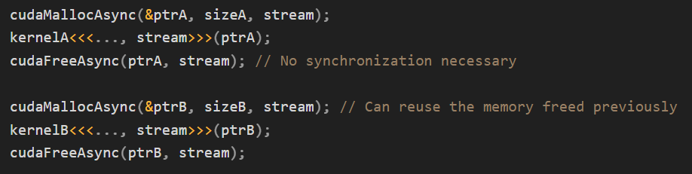
4. CUDA Stream-ordered Memory allocator

Slide 24
4.1. CUDA Memory Pools
The stream-ordered memory allocator introduces the concept of memory pools to CUDA.
A memory pool is a collection of previously allocated memory that can be reused for future allocations.
Streams can have their own memory pool or share one with others.
(Device has default memory pool.)

Slide 25
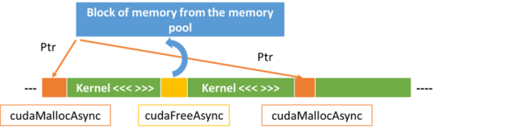
4.1. CUDA Memory Pools
Each call to cudaMallocAsync attempts to allocate memory from that device’s current pool.
Each call to cudaFreeAsync returns memory to the pool, which is then available for re-use on subsequent cudaMallocAsync requests.

Slide 26
4.2. Managing Memory pool
Principle : System call to OS for memory request and return is considered very expensive.
By default,
If the pool has insufficient memory, the CUDA driver calls into the OS to allocate more memory.
Unused memory in the pool is returned to the OS during the next synchronization operation.

Slide 27
4.3. Release threshold
The application can configure a release threshold to enable unused memory to persist beyond the synchronization operation.
By default, the release threshold is zero.
i.e. all unused memory in the pool is released back to the OS during every synchronization operation.

Slide 28
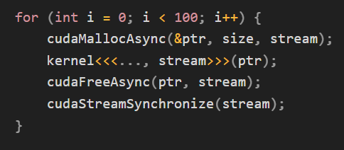
4.3. Release threshold
In this example, release happens at the end of every iteration.
As a result,
there is no memory to reuse for the next cudaMallocAsync call
and instead memory must be allocated through an expensive system call.

Slide 29
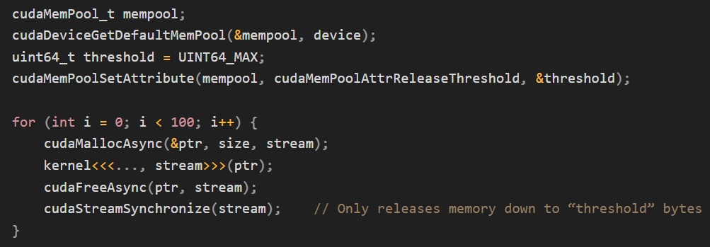
4.3. Release threshold
Therefore, good memory allocator (or manager) should search for “good” release threshold.
Example : When using maximum release threshold. (result in next)

Slide 30
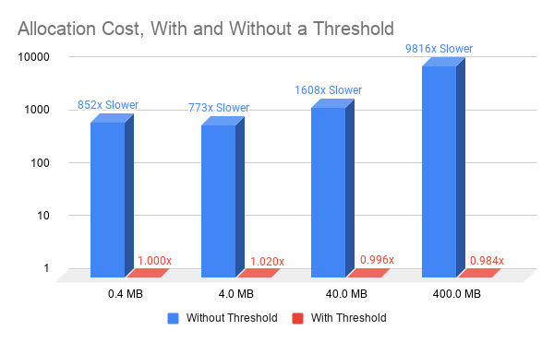
4.3. Release threshold

Slide 31
5.1. Cross-GPU ops in PyTorch CUDA
Cross-GPU operations are not allowed by default,
with the exception of
copy_()
and other methods with copy-like functionality such as to() and cuda().
Unless you enable peer-to-peer memory access,
any attempts will raise an error;
e.g. to launch ops on tensors spreaded across different devices.

Slide 32
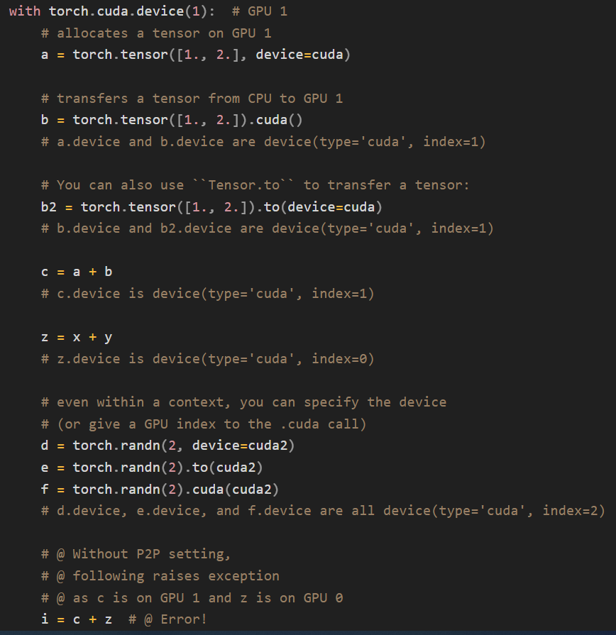
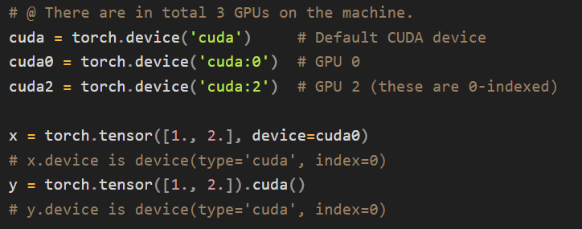
5.1. Cross-GPU ops in PyTorch CUDA

Slide 33
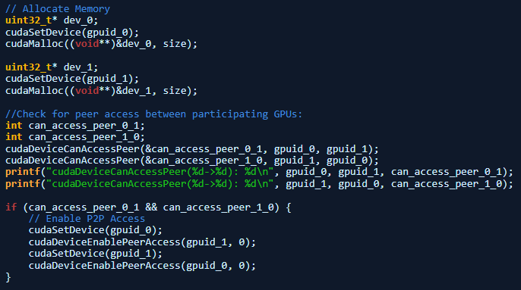
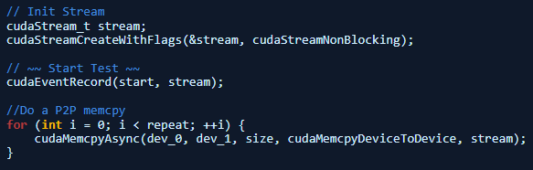
5.2. With P2P capability
Accessing the memory from any other device requires the two devices to be peer capable, as reported by cudaDeviceCanAccessPeer.

Slide 34
5.2. With P2P capability
By default, memory allocated using cudaMallocAsync is only accessible from the device associated with the specified stream.
Accessing the memory from any other device requires enabling access to the entire pool from that other device.
However, unlike cudaMalloc allocations,
cudaDeviceEnablePeerAccess and cudaDeviceDisablePeerAccess have no effect on memory allocated from memory pools.

Slide 35
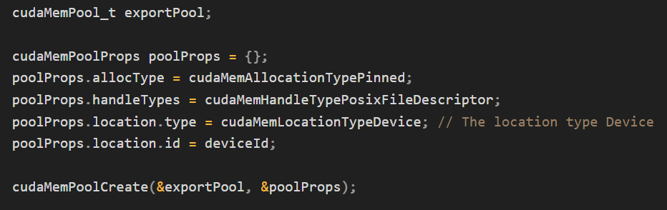
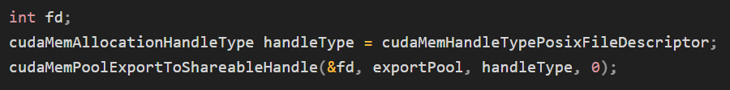
5.3. IPC support for stream memory pool
Stream memory pool can be wrapped and exported as an handle.
Such pool handle can be shared and transported through common IPC; e.g. UNIX socket or Pipe, (@ possibly TensorPipe)

Slide 36
6. CUDA Stream-ordered Memory allocator Benchmark
NVIDIA provided benchmark results from the RAPIDS GPU Big Data Benchmark (gpu-bdb).
gpu-bdb is a benchmark of 30 queries representing real-world workflows that can include
SQL,
user-defined functions,
careful subsetting and aggregation,
and machine learning.

Slide 37
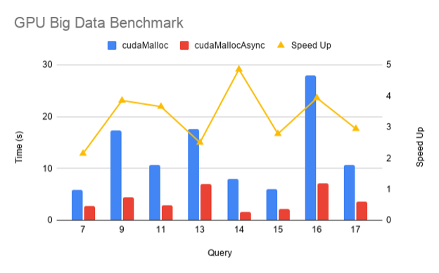
6. CUDA Stream-ordered Memory allocator Benchmark
Thanks to
memory reuse (memory pool)
and eliminating extraneous synchronization,
there’s a 2–5x improvement in end-to-end performance
when using cudaMallocAsync.

